Slide 1





“Updates in epithelial neoplasias of the lower genital tract”
Gustavo Rubino de Azevedo Focchi
Dept. of Pathology (UNIFESP); DASA Laboratory

Slide 2
Disclosure of Relevant Financial Relationships
Dr. Gustavo Rubino de Azevedo Focchi
declares he has no conflict(s) of interest to disclose
RDC Nº 96/08 da ANVISA

Slide 3
SCC - CERVIX: HPV-independent
International Squamous Cell Carcinoma Project (ISCCP); USA, Canada, Romania, Italy, Sweden, Japan; cases from different periods spanning from 1992 to 2021; 670 cases
447 cases with available tissue; TMA; HPV-RNA ISH (LR and HR); P16, P53 IHC
HPV-independent: negative by ISH and no diffuse P16 positivity; HPV-associated: positive by ISH
10 HPV-I (2%) and 435 HPV-A cases; 2 equivocal cases (excluded)
P53 IHC: 2 null; 8 wild type
HPV-I when compared with HPV-A: significantly older (median age 72 vs. 49) and diagnosed at a higher stage (40% vs. 18% stage III/IV)
2 patients had distant recurrences and 3 died of disease
Stolnicu S, Allison D, Praiss AM et al. – Am J Surg Pathol, 2023, 47: 1376-1389.

Slide 4
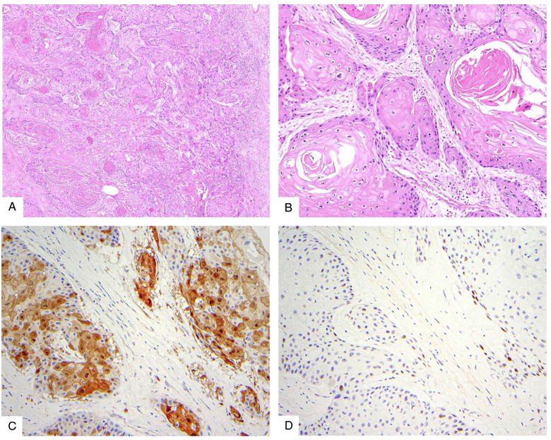
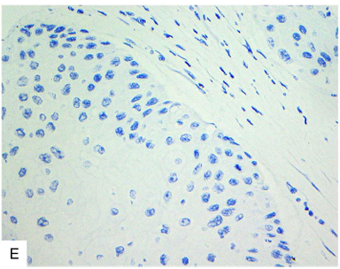
Stolnicu S, Allison D, Praiss AM et al. – Am J Surg Pathol, 2023, 47: 1376-1389.

Slide 5
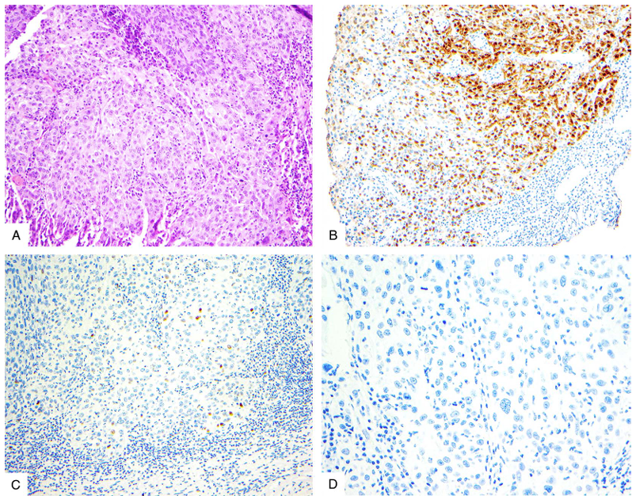
Stolnicu S, Allison D, Praiss AM et al. – Am J Surg Pathol, 2023, 47: 1376-1389.

Slide 6
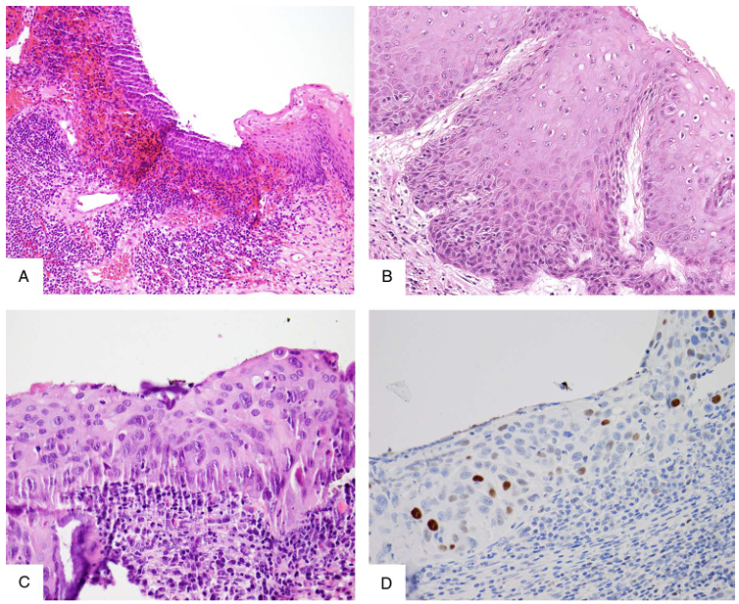
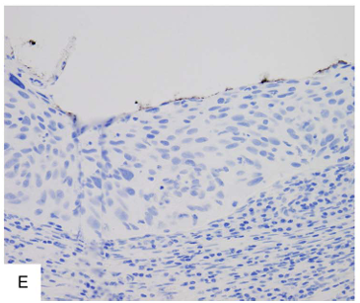
Stolnicu S, Allison D, Praiss AM et al. – Am J Surg Pathol, 2023, 47: 1376-1389.

Slide 7
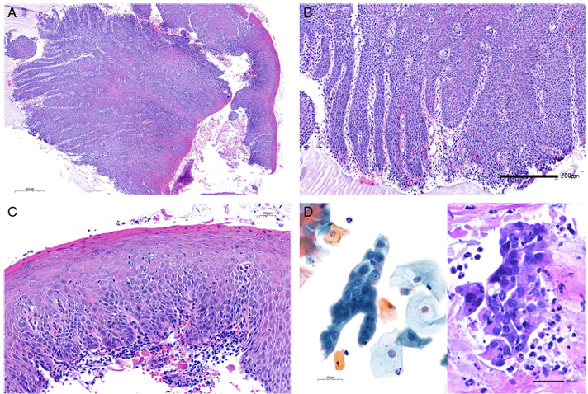
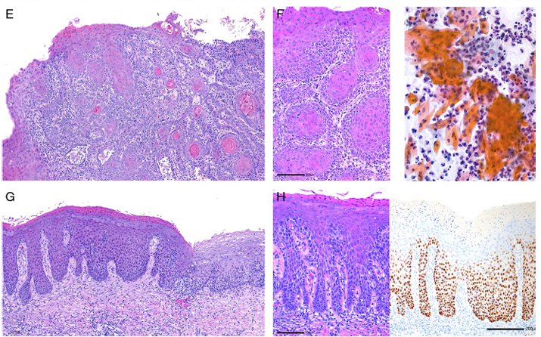
HPV-independent CIN
“P53-mutated dCIN”
Regauer S, Reich O – Am J Surg Pathol, 2023: 47:942-949.

Slide 8
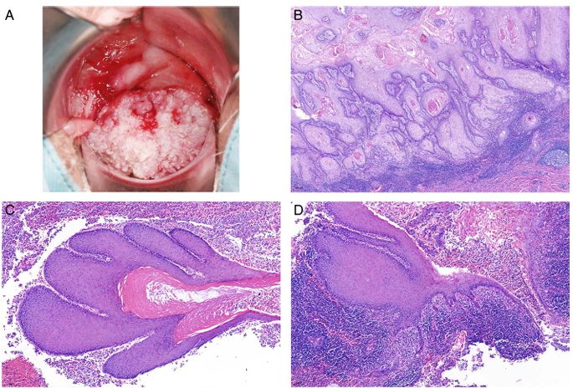
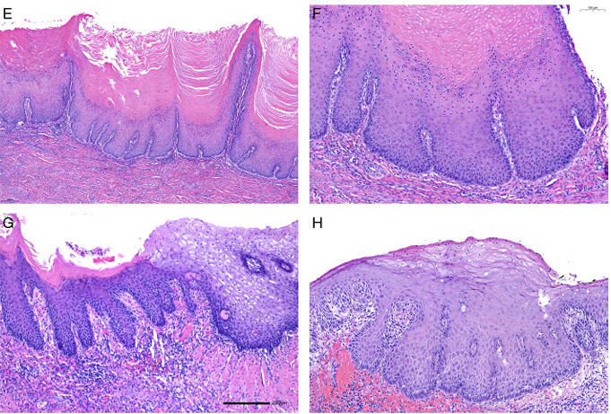
HPV-independent CIN
“P53-wild type verruciform CIN”
Regauer S, Reich O – Am J Surg Pathol, 2023: 47:942-949.

Slide 9
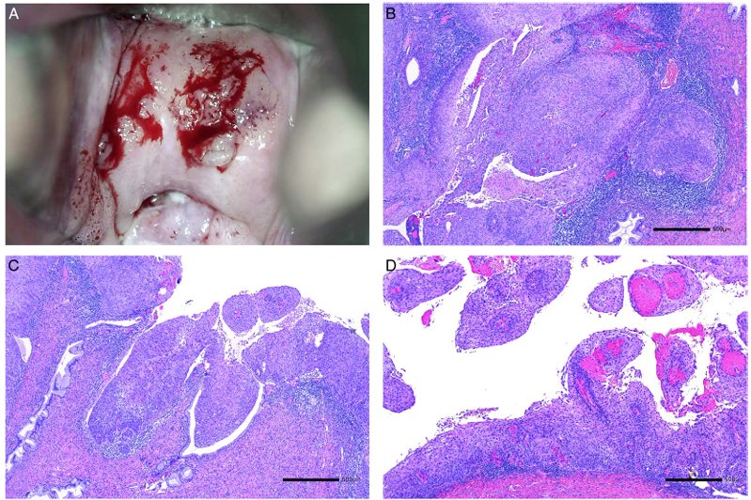
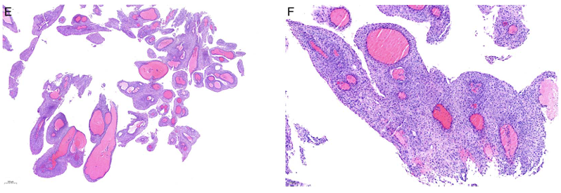
HPV-independent CIN
“P53-wild type verruciform CIN”
Regauer S, Reich O – Am J Surg Pathol, 2023: 47:942-949.

Slide 10
SCC - CERVIX: LVI
ISCCP (670 cases; USA, Canada, Romania, Italy, Sweden, Japan; different periods spanning from 1992 to 2021)
FIGO 2018 stage: I (72%); II (11%); III (17%); IV (1%); unknown (n=31)
LVI: focal (< 5 spaces); extensive (> 5 spaces)
LVI independently predicts worse survival outcomes
Extensive LVI: worse progression-free survival (PFS)
Quantification of LVI should be considered in pathology reports
Praiss AM, Allison D, Tessier-Cloutier B et al.– Gynecol Oncol, 2023, 176: 147-154.

Slide 11
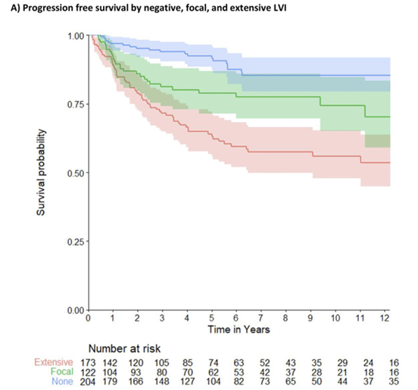
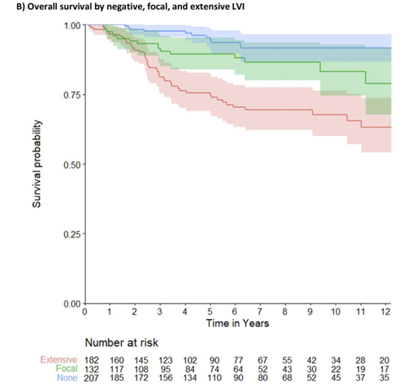
Praiss AM, Allison D, Tessier-Cloutier B et al.– Gynecol Oncol, 2023, 176: 147-154.

Slide 12
SCC - CERVIX: TUMOR GRADING
Not recommended.
Not included as a core or non-core item.
Considerable subjectivity component (Broders / WHO).
Not been shown to consistently correlate with outcome.
Almost all tumors are HPV-associated and commonly basaloid and graded as poorly differentiated; paradox: HPV-independent tumors (mostly keratinising and well-differentiated) have a worse prognosis than HPV-associated tumors (mostly non-keratinising, basaloid and poorly differentiated) !!!
Grading of very small superficially (“early”) invasive carcinomas is probably not possible or relevant
ICCR, Carcinoma of the Cervix Histopathology Reporting Guide, 5th. Ed., 2023.

Slide 13

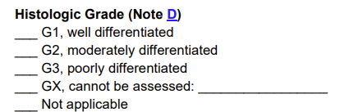

Slide 14
SCC - CERVIX: NEW GRADING SYSTEM (I)
two completely independent cohorts from two different centres: test cohort (n= 125; 1991-2016) and independent validation cohort (n= 122; 2000-2016)
Stages: pT1b: 67% and 70,5%; LNI: 28% and 21%
tumor budding activity and cell nest size; keratinization, nuclear size; mitotic activity, tumor stroma
Small nest size and high tumor budding: strongly associated with worse overall survival (OS), disease-specific survival (DSS) and disease-free survival (DFS)
New grading system based on cell nest size and tumor budding: stage-independent prognosticator in both cohorts and superior to WHO grading system
Jesinghaus M, Strehl J, Boxberg M et al.– J Pathol: Cin Res, 2018, 4: 93-102.

Slide 15
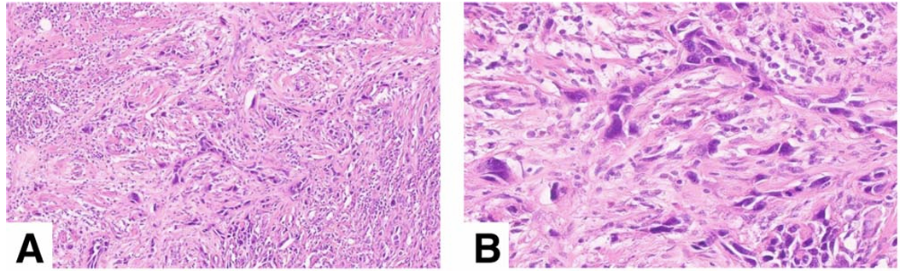
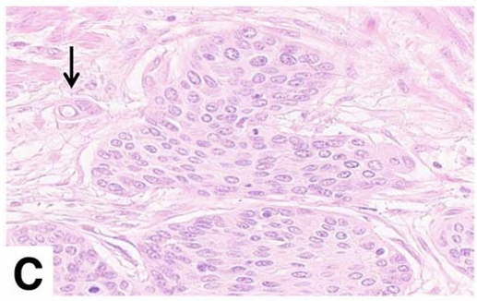
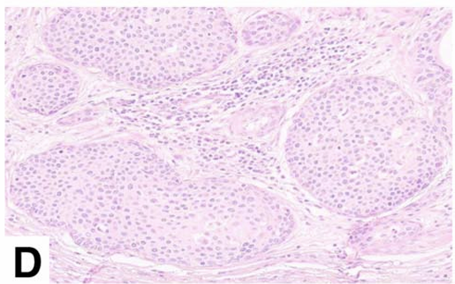
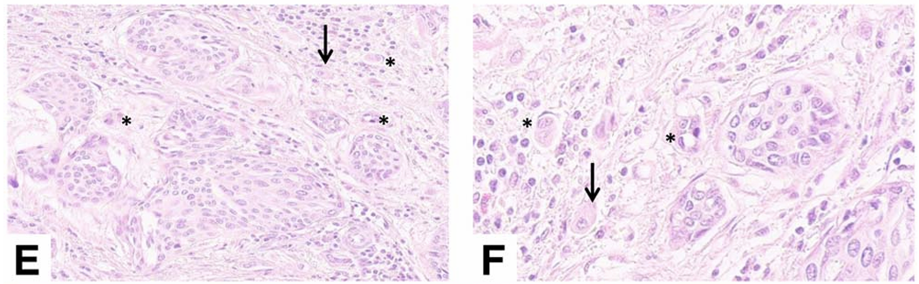
High tumor budding
Low tumor budding
Large and medium cell nests
Small cell nests (stars) and single cell invasion (arrows)
Jesinghaus M, Strehl J, Boxberg M et al.– J Pathol: Cin Res, 2018, 4: 93-102.

Slide 16
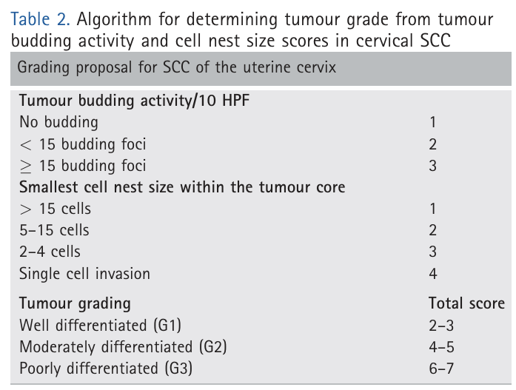
Jesinghaus M, Strehl J, Boxberg M et al.– J Pathol: Cin Res, 2018, 4: 93-102.

Slide 17
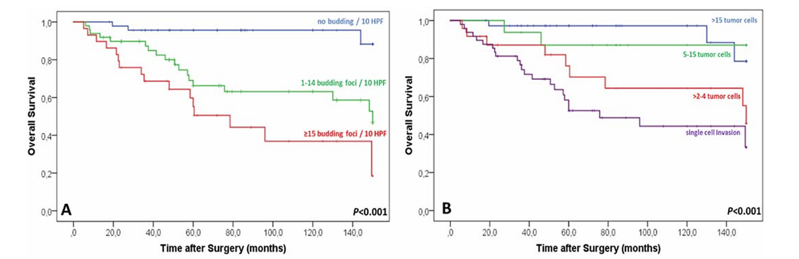
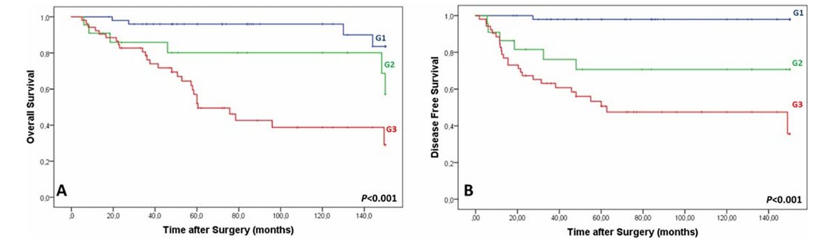
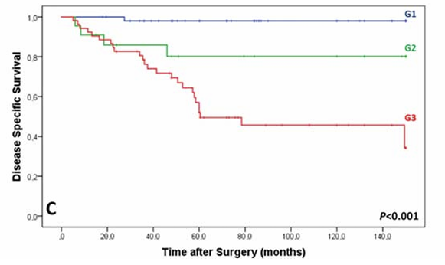
Jesinghaus M, Strehl J, Boxberg M et al.– J Pathol: Cin Res, 2018, 4: 93-102.

Slide 18
SCC - CERVIX: NEW GRADING SYSTEM (II)
94 consecutive surgically-excised therapy-naive cases; pT1b or higher
tumor budding activity and cell nest size (TBNS system)
Small nest size and high tumor budding: each individually associated with reduced OS, DSS and DFS
Full TBNS: associated with reduced OS, DSS and DFS independent of patient age, pathologic stage and regional lymph node status; validation of the previous study
Keratinization, nuclear size, mitotic count and WHO grade: not associated with decreased OS
Zare SY, Aisagbonhi O, Hasteh F et al.– Am J Surg Pathol, 2020: 44:1151-1160.

Slide 19
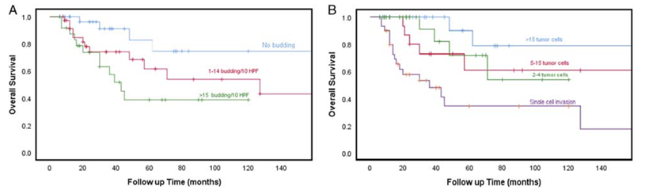
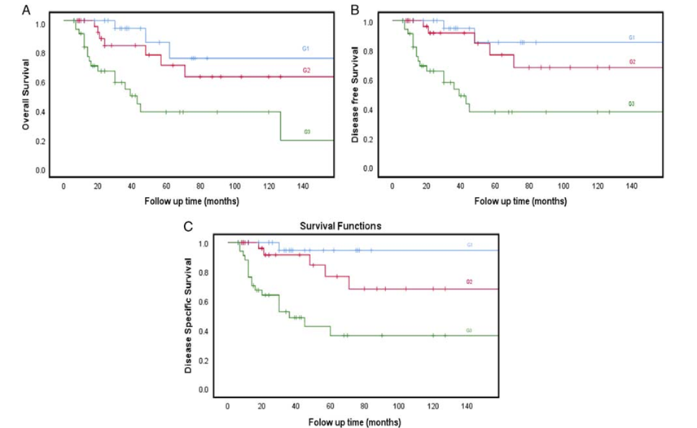
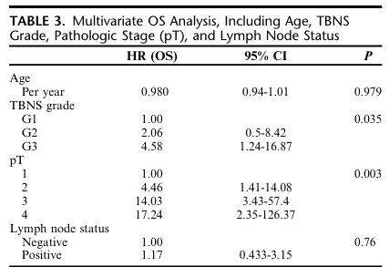
Zare SY, Aisagbonhi O, Hasteh F et al.– Am J Surg Pathol, 2020: 44:1151-1160.

Slide 20
SCC - CERVIX: NEW GRADING SYSTEM (III)
ISCCP (670 cases; USA, Canada, Romania, Italy, Sweden, Japan; different periods spanning from 1992 to 2021)
Grading systems: original Broders (586); consensus Broders (587); Jesinghaus (587); Silva (584); tumor stroma (fibrous or myxoid) (556)
Stolnicu S, Praiss AM, Allison D et al.– Int J Gyn Pathol, 2024, 43: 203-214.

Slide 21
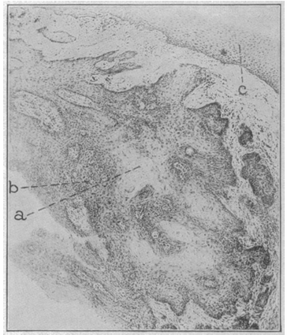
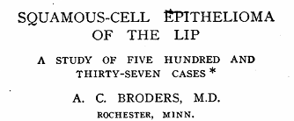
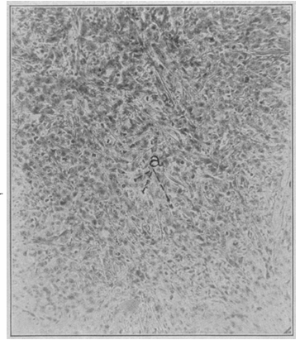

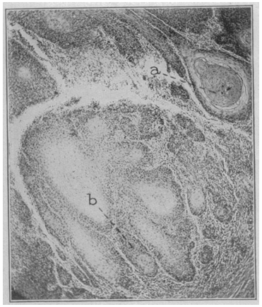
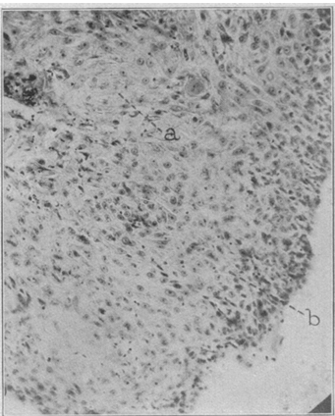
Gr. 2: ~ 50% differentiated cells
Gr. 3: ~ 25 % differentiated cells
Gr. 1: ~ 75% differentiated cells
Gr. 4: ~ 0% differentiated cells

Slide 22
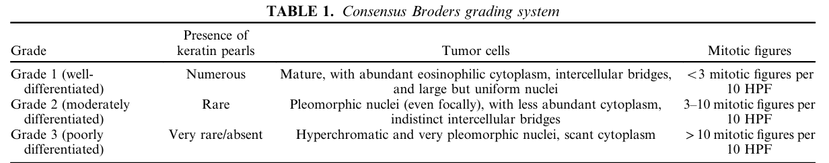
Stolnicu S, Praiss AM, Allison D et al.– Int J Gyn Pathol, 2024, 43: 203-214.

Slide 23
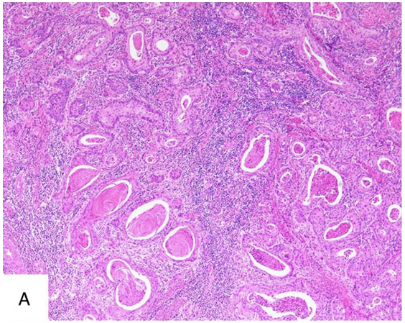
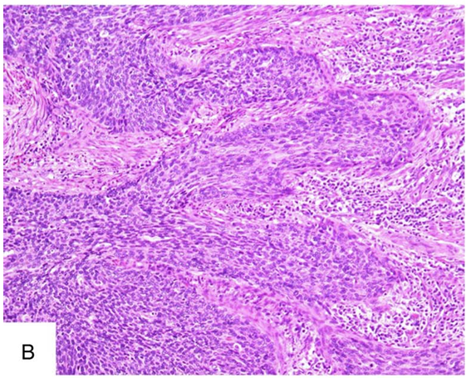
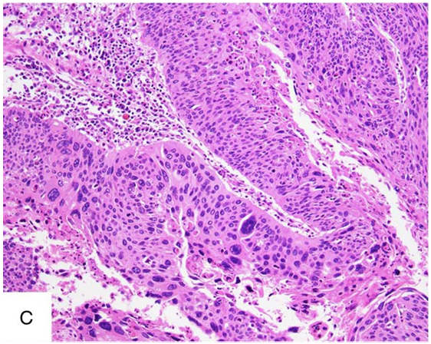
Stolnicu S, Praiss AM, Allison D et al.– Int J Gyn Pathol, 2024, 43: 203-214.

Slide 24
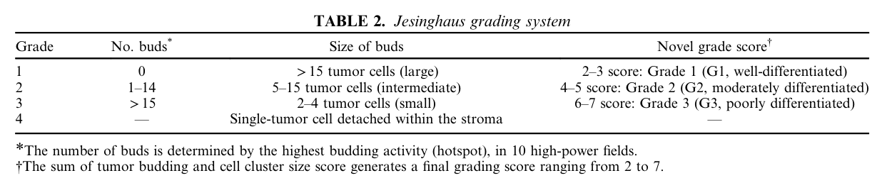
Stolnicu S, Praiss AM, Allison D et al.– Int J Gyn Pathol, 2024, 43: 203-214.

Slide 25
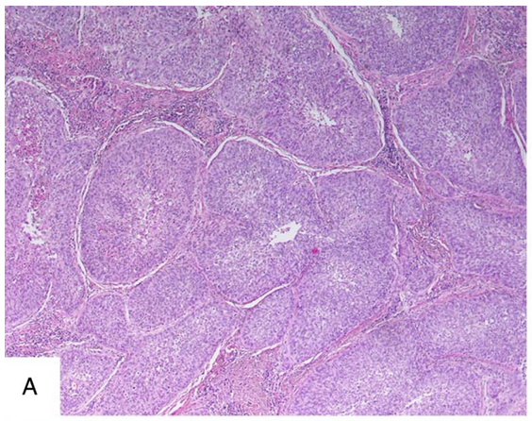
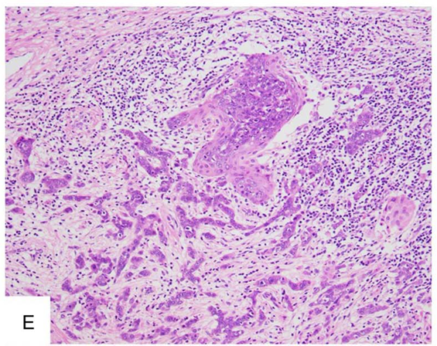
Stolnicu S, Praiss AM, Allison D et al.– Int J Gyn Pathol, 2024, 43: 203-214.

Slide 26
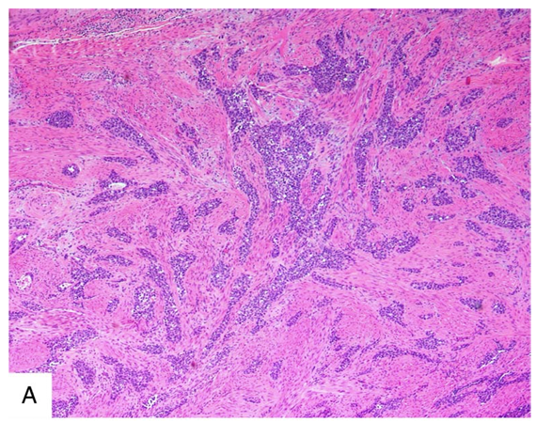
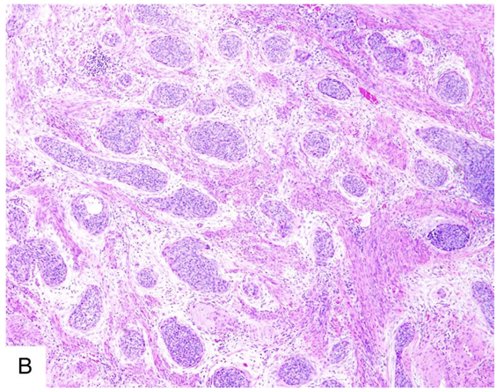
Stolnicu S, Praiss AM, Allison D et al.– Int J Gyn Pathol, 2024, 43: 203-214.

Slide 27
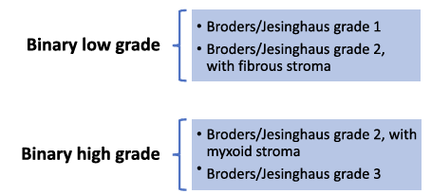
Stolnicu S, Praiss AM, Allison D et al.– Int J Gyn Pathol, 2024, 43: 203-214.

Slide 28
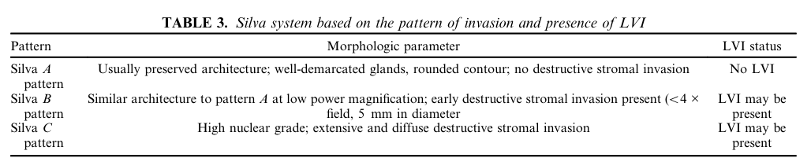
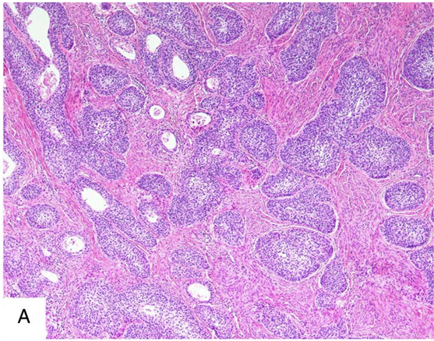
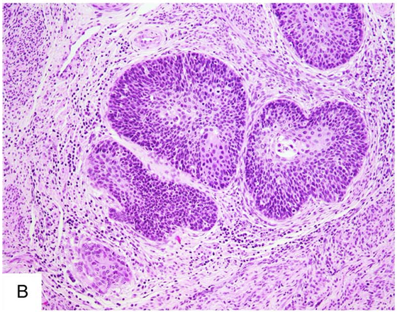
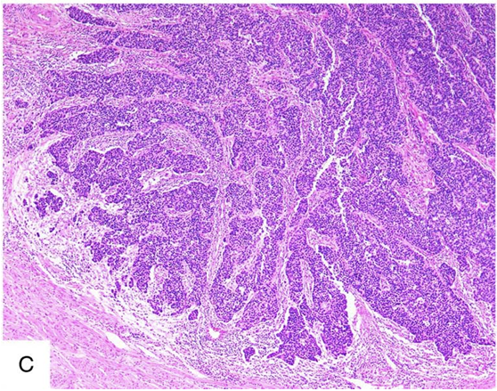
Stolnicu S, Praiss AM, Allison D et al.– Int J Gyn Pathol, 2024, 43: 203-214.

Slide 29
SCC - CERVIX: NEW GRADING SYSTEM (III)
ISCCP (670 cases; USA, Canada, Romania, Italy, Sweden, Japan; different periods spanning from 1992 to 2021)
Grading systems: original Broders (586); consensus Broders (587); Jesinghaus (587); Silva (584); tumor stroma (fibrous or myxoid) (556)
Poor reproducibility among grading systems; limited predictive accuracy; binary Broders and binary Jesinghaus: improved predictive accuracy for survival and lymph node metastasis
Stolnicu S, Praiss AM, Allison D et al.– Int J Gyn Pathol, 2024, 43: 203-214.

Slide 30
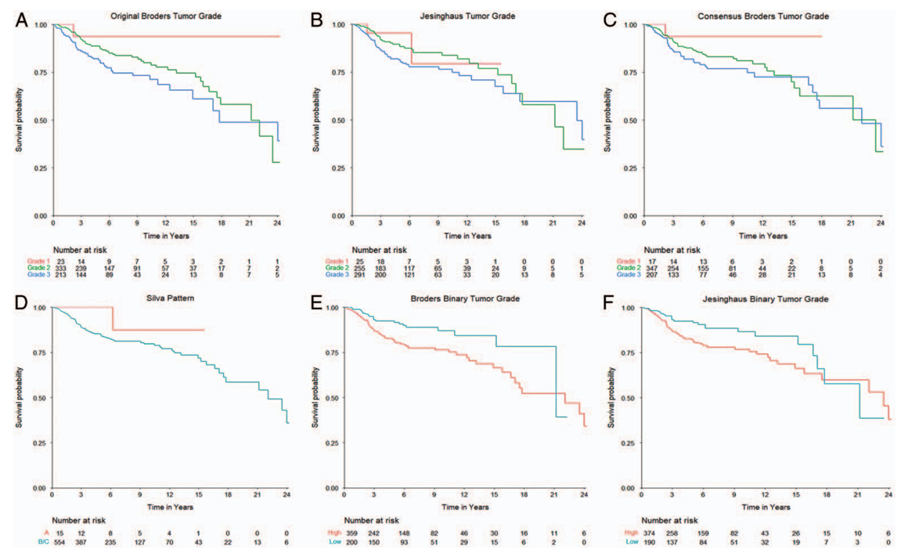
OS
Stolnicu S, Praiss AM, Allison D et al.– Int J Gyn Pathol, 2024, 43: 203-214.

Slide 31
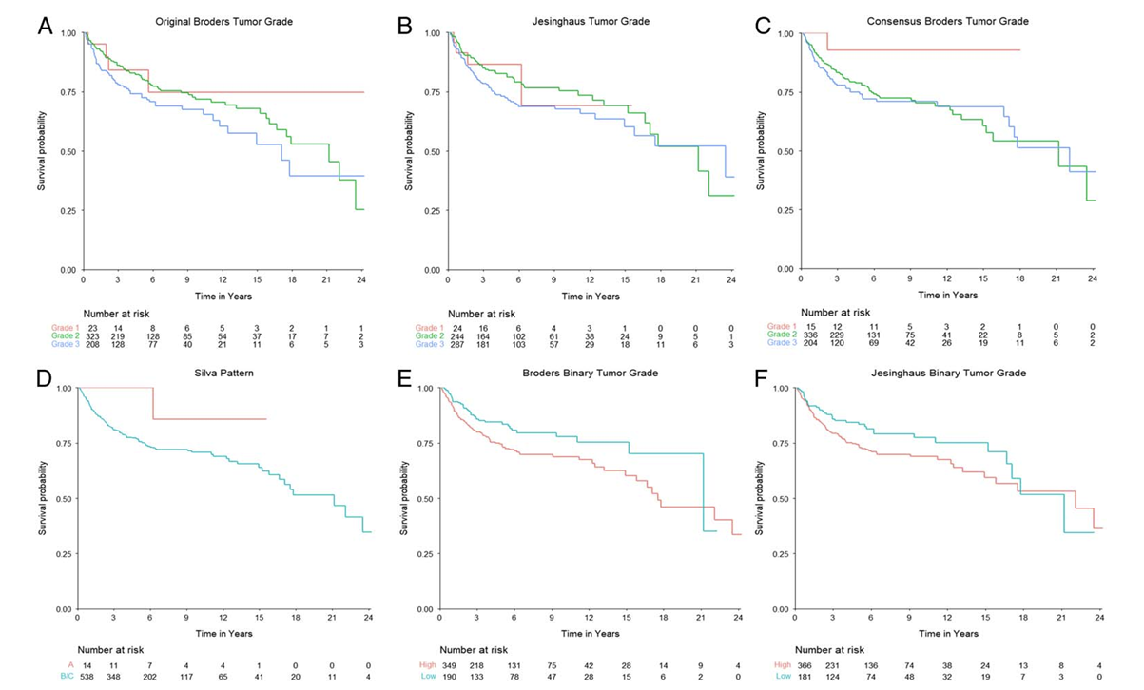
PFS
Stolnicu S, Praiss AM, Allison D et al.– Int J Gyn Pathol, 2024, 43: 203-214.

Slide 32
SCC - VULVA: TUMOR GRADING
Not recommended.
Not included as a core or non-core item.
Not been shown to consistently correlate with outcome.
Paradox: HPV-independent tumors (mostly keratinising and well-differentiated) have a worse prognosis than HPV-associated tumors (mostly non-keratinising, basaloid and poorly differentiated) !!!
ICCR, Carcinoma of the Vulva Histopathology Reporting Guide, 2th. Ed., 2023.

Slide 33
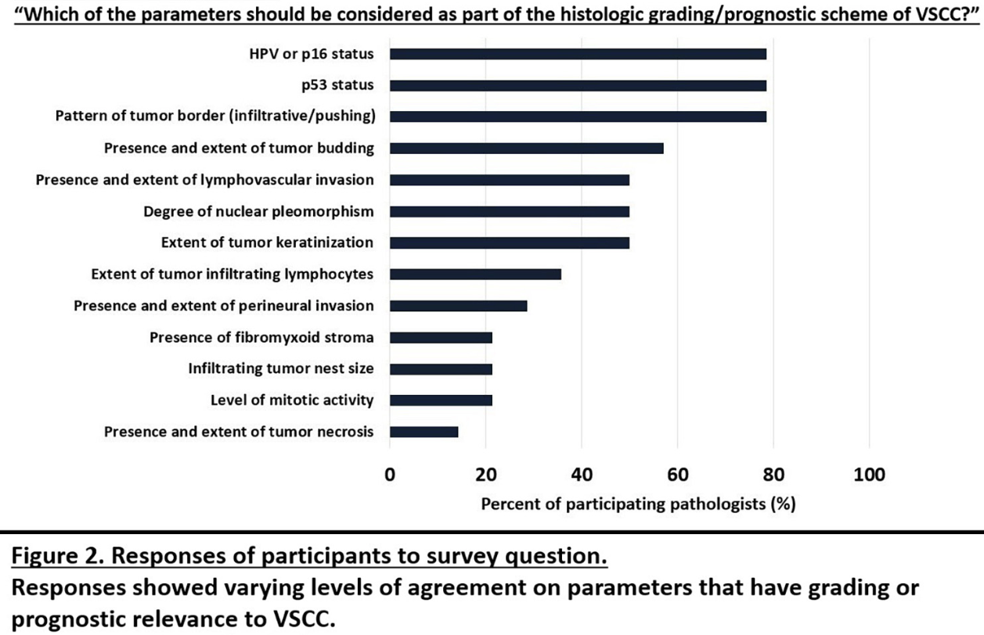
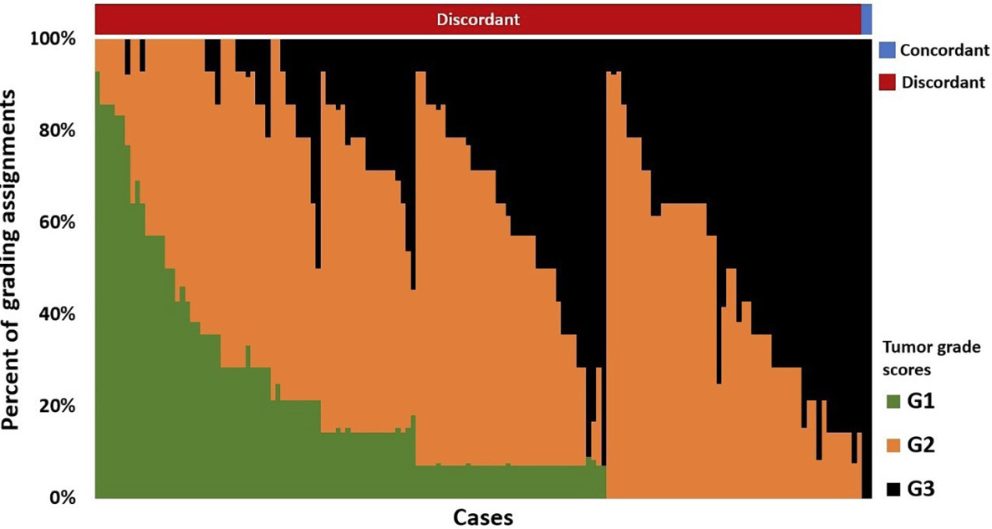
Soong TA, Alvarado-Cabrero A, Bosse T et al – Poster Session - USCAP 2024

Slide 34
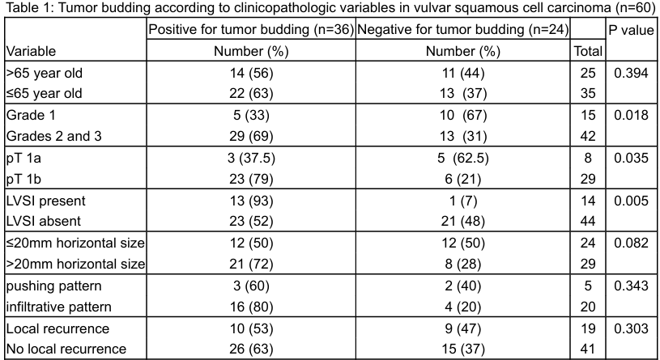
Hossain M, El Mandy M, Farid L et al. – Stowell-Orbison Session - USCAP 2024

Slide 35
SCC - VULVA: TUMOR BUDDING ACTIVITY
82 cases of surgically excised tumors
tumor budding activity (TBA): no, low (1-14 foci) and high (>15 foci)
33 (29,1%): no TBA; 37 (45,1%): low TBA; 22 (26,8%): high TBA
high TBA: associated with reduced OS on multivariate analysis independent of FIGO stage, HPV status and p53 status
Majority (77,3%, 17 of 22) of tumors with high TBA had P53 mutant staining pattern; 17 patients with p53 mutant / high TBA: worse outcomes when compared with 15 patients with p53 mutant /no TBA or p53 mutant / low TBA
High TBA: 5 of 47 HPV-associated cases; worse outcome when compared with the rest of the HPV-associated cohort
Zare SY, Ciscato A, Fadare O – Hum Pathol, 2022, 126: 77-86.

Slide 36
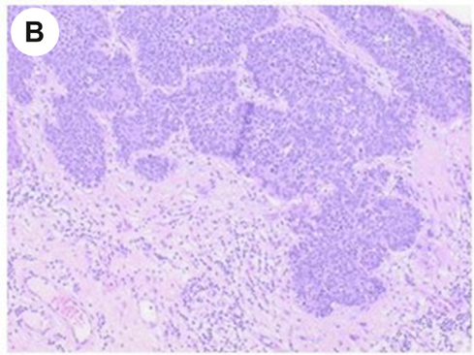



Zare SY, Ciscato A, Fadare O – Hum Pathol, 2022, 126: 77-86.

Slide 37


Corbin HN, Desouki MM, Focchi GRA et al. – Platform Session - USCAP 2024

Slide 38

Corbin HN, Desouki MM, Focchi GRA et al. – Platform Session - USCAP 2024

Slide 39




Lin LH, Kaur H, Kolin DL et al. - Stowell-Orbison Session - USCAP 2024

Slide 40
Thank You!

Slide 41

LEEP/conization, trachelectomy, histerectomy
Silva A (16), Silva B (3), Silva C (19)
LR: Silva A and Silva B LVI (-): 18 cases
HR: Silva B LVI (+) and Silva C: 20 cases
4 recurrences: 1 Silva B LVI (+) and 3 Silva C
Dodington D, Zyla R, Hodgson A - Poster Session - USCAP 2024

Slide 42

Yang H, Almadani N, Thopson EF et al. – Mod Pathol, 2023, 36, 100145

Slide 43


Barbera L, Gien T, Sutradhar R et al. - Int J Gyn Pathol, 2017, 36, 2, 107-10.

Slide 44


Slide 45


Slide 46


Slide 47



Slide 48

Tessier-Cloutier B, Kortekaas KE, Thompson EF et al. - Mod Pathol. 2020 Aug;33(8):1595-1605.

Slide 49



Höhn AK, Forberger M, Alfaraidi M et al. – Gynecol Oncol, 2024, 185: 17-24.

Slide 50

SCC - CERVIX: HPV-independent
Stolnicu S, Allison D, Praiss AM et al. – Am J Surg Pathol, 2023, 47: 1376-1389.

